Slide 1
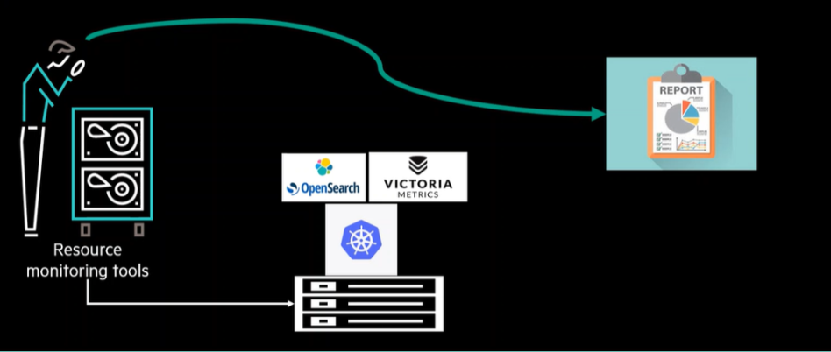
HPE CTY: TEAM-3
CAPACITY ADVISOR FOR MONITORING RESOURCES

Slide 2
What is the Project About? In modern cloud-native and data-intensive environments, efficient resource monitoring is critical to ensure system reliability, scalability, and cost-effectiveness. This project aims to build a comprehensive, real-time resource monitoring and capacity advisory framework for services such as Apache Kafka. Objectives: 1. Develop an algorithm that advises on resource or capacity needs based on the types of monitoring services. 2. Build a monitoring framework to capture the utilization of resources such as disk space, memory, and CPU usage, integrating various monitoring solutions like. 3. Creating Comprehensive Weekly Reports containing graphs and usage statistics over time (hourly,monthly,weekly)

Slide 3
Features: 1.Continuously monitors CPU, memory, and disk utilization of services like Kafka 2.ML model that gives alerts under stress condition when a threshold is reached telling the users to take necessary actions in order to prevent system crashes. 3.Uses JMX Exporter and Node Exporter to collect kafka and system metrics respectively, Prometheus for scraping, and Grafana for visualization. 4.Captures and stores metrics over time (hourly/daily/weekly). Exports Prometheus metrics as CSV for offline analysis or machine learning training. 5.Pre-built Grafana dashboards for monitoring each service individually and comparatively. Technologies Used: The project utilizes the following technologies and tools for development and deployment: 1. Programming Languages: Python, Bash Scripting 2. Cloud Platforms: AWS 3. Streaming & Monitoring Platforms: 4. Apache Kafka (real-time event streaming) 5. Node Exporter (collects system metrics such as CPU, memory, disk usage, and network statistics for Prometheus) 6. Prometheus (powerful metrics monitoring and alerting system)

Slide 4
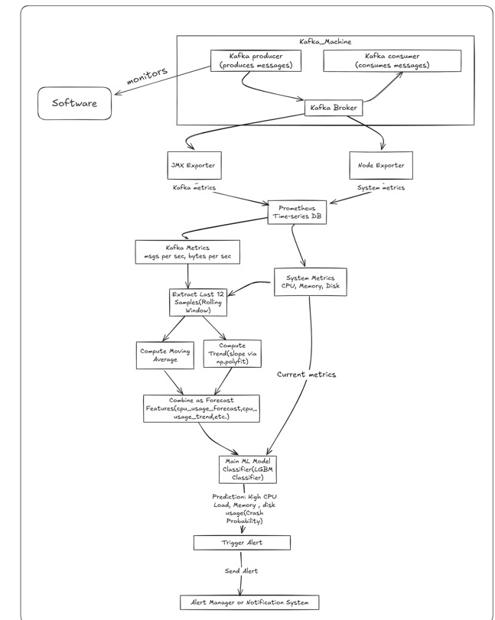
ARCHITECTURE DIAGRAM

Slide 5
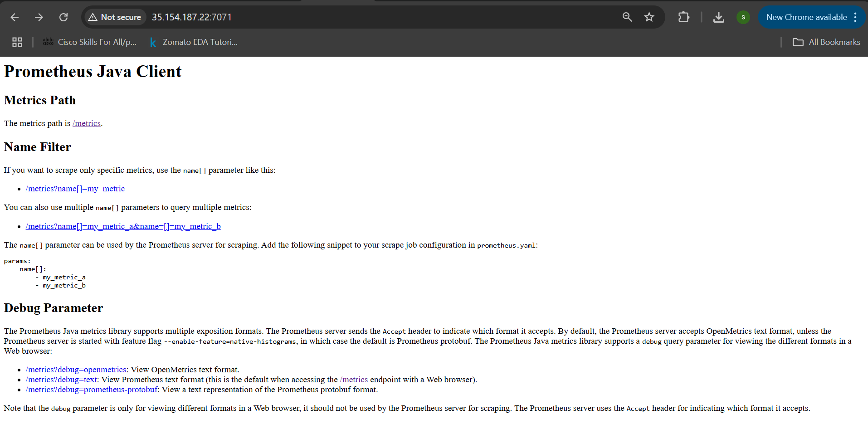
II. Install Dependencies
I. System Preparation
Install Java:
sudo yum install java-1.8.0-openjdk -y
Setup Kafka:
wget https://dlcdn.apache.org/kafka/3.9.0/kafka_2.12-3.9.0.tgztar -xvf kafka_2.12-3.9.0.tgz
Start Zookeeper:
nohup bin/zookeeper-server-start.sh config/zookeeper.properties > zookeeper.log 2>&1 &
Setup JMX exporter:
wget https://repo1.maven.org/maven2/io/prometheus/jmx/jmx_prometheus_jav aagent/1.0.1/jmx_prometheus_javaagent-1.0.1.jar
Start Kafka wih JMX (PORT 7071)
export KAFKA_OPTS="$KAFKA_OPTS -javaagent:/opt/jmx-exporter/jmx_prometheus_javaagent-1.0.1.jar=7071:/opt/jmx-exporter/kafka-jmx-config.yaml"
nohup bin/kafka-server-start.sh config/server.properties > kafka.log 2>&1 &
Create swap file:
sudo fallocate -l 2G /swapfile
sudo chmod 600 /swapfile
sudo mkswap /swapfile
sudo swapon /swapfile
Update packages:
sudo yum update -y

Slide 6
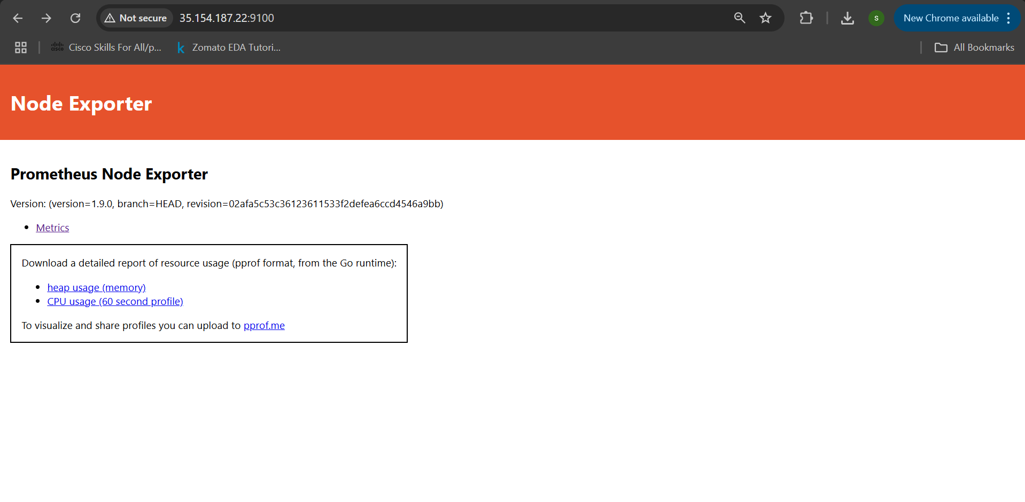
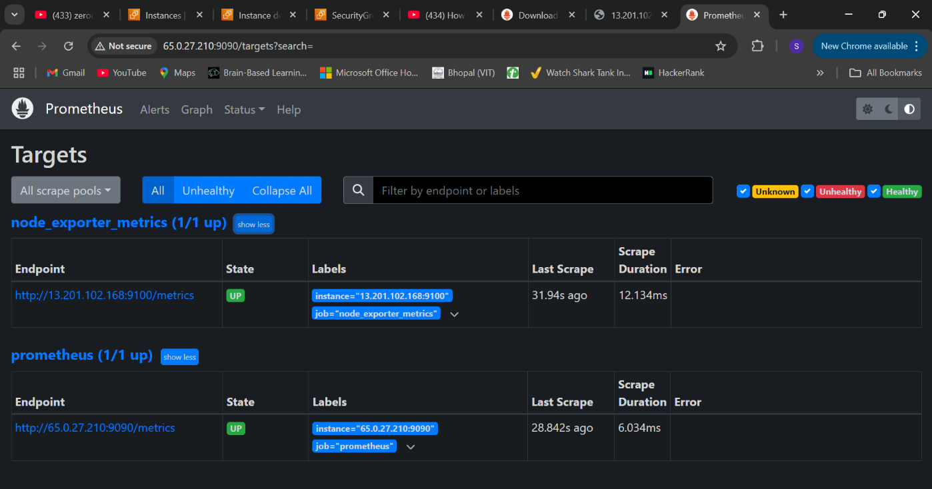
III. Monitoring Setup
Install And Start Node Exporter (Port 9100)
wget https://github.com/prometheus/node_exporter/releases/latest/download/node_exporter-1.8.1.linux-amd64.tar.gz
nohup ./node_exporter > node_exporter.log 2>&1 &
Install And Start Prometheus (Port 9090)
wget https://github.com/prometheus/prometheus/releases/download/v2.51.0/prometheus-2.51.0.linux-amd64.tar.gz
nohup ./prometheus --config.file=prometheus.yml > prometheus.log 2>&1 &

Slide 7
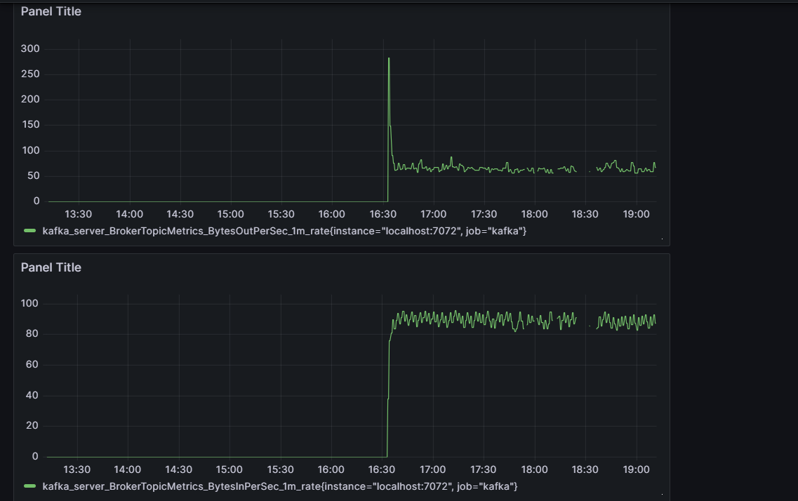
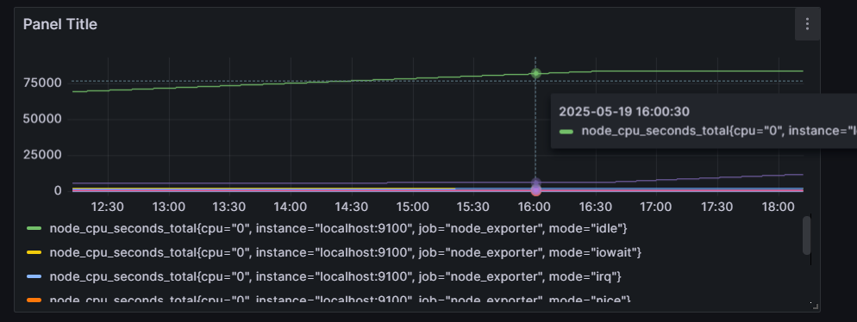
Install And Start Grafana: (Port 3000)
sudo yum install -y https://dl.grafana.com/oss/release/grafana-10.0.3-1.x86_64.rpm
sudo systemctl daemon-reexec
sudo systemctl enable grafana-server
sudo systemctl start grafana-server

Slide 8
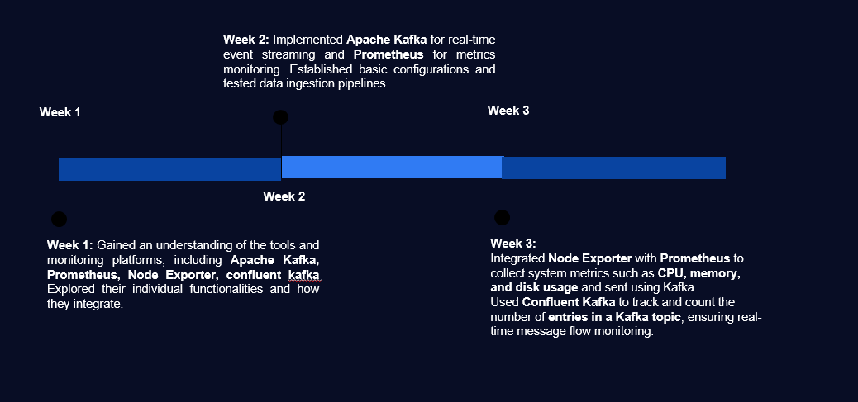
PROGRESS:

Slide 9

Collecting Metrics: Kafka & Prometheus
To evaluate how Kafka behaves under storage pressure, we begin by configuring system monitoring for memory, CPU, and disk usage. Node exporter and Jmx exporter are deployed to capture key system metrics & kafka server metrics in real-time.
With monitoring in place, we simulate Kafka message load and observe how disk usage grows over time—laying the groundwork for controlled disk stress scenarios.

Slide 10

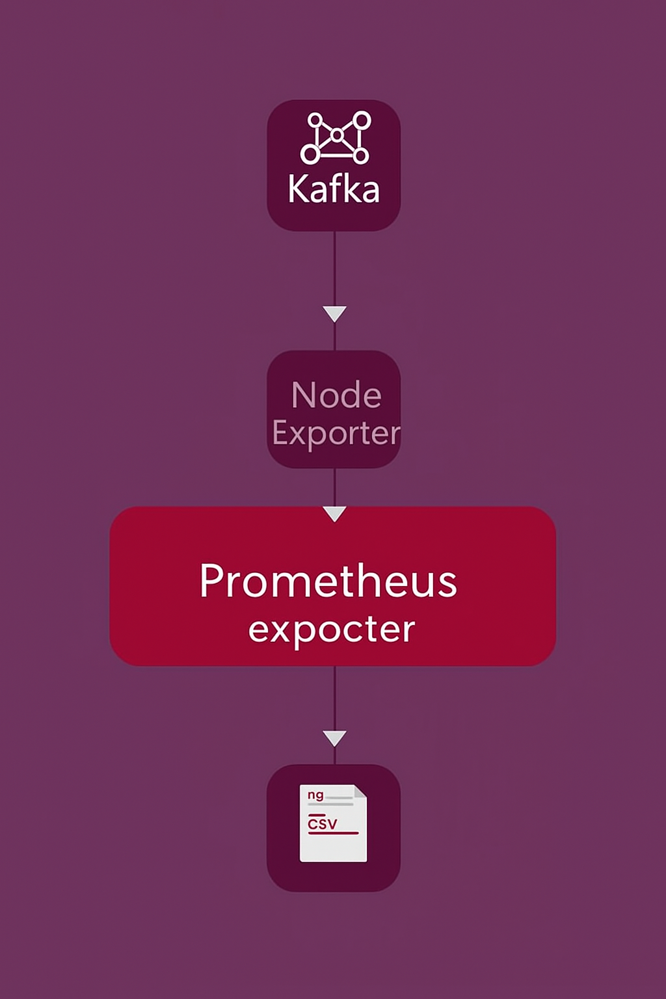
Monitoring Pipeline Overview
Our system monitors Kafka memory and system metrics. It uses Prometheus exporters to collect data. The pipeline simulates message load and logs metrics to a CSV file.
Kafka Message Load through producer script.
1
Node Exporter & JMX Exporter.
2
Metric Collection
3

Slide 11

Main Metrics Scraping Script
This script collects Kafka and system metrics. It uses JMX Exporter (port 7071) and Node Exporter (port 9100). Metrics include Kafka messages/bytes and system CPU/memory/disk usage.
#Memory Usagemem_total = extract_value("node_memory_MemTotal_bytes",{})
mem_avail = extract_value("node_memory_MemAvailable_bytes", {})
if mem_total and mem_avail:
memory_usage = (1 - mem_avail / mem_total)*100
else:
memory_usage = 0.0
The script logs all collected metrics to 'kafka_node_metrics.csv' every 4 seconds.

Slide 12
DISK STRESS TEST
Why Test Disk-Full Conditions?
Testing for disk-full conditions is critical because:
Simulating “Out of Space” Failures: In real-world scenarios, applications can unexpectedly run into storage limits. By simulating these failures, we can observe how our software behaves when the disk is full — whether it crashes, throws errors, or handles the situation gracefully.
Key Goals of This Test:
Quickly Consume Disk Space Without Heavy I/O: Instead of writing large amounts of real data — which can be slow and resource-intensive — we use sparse file allocation to instantly reserve space on disk with minimal overhead.
Leave a Precise 20 KB Buffer: We always leave 20 kilobytes of free space. This small buffer helps prevent the system from entering a completely unusable state and allows us to safely observe behavior near the failure threshold.

Slide 13
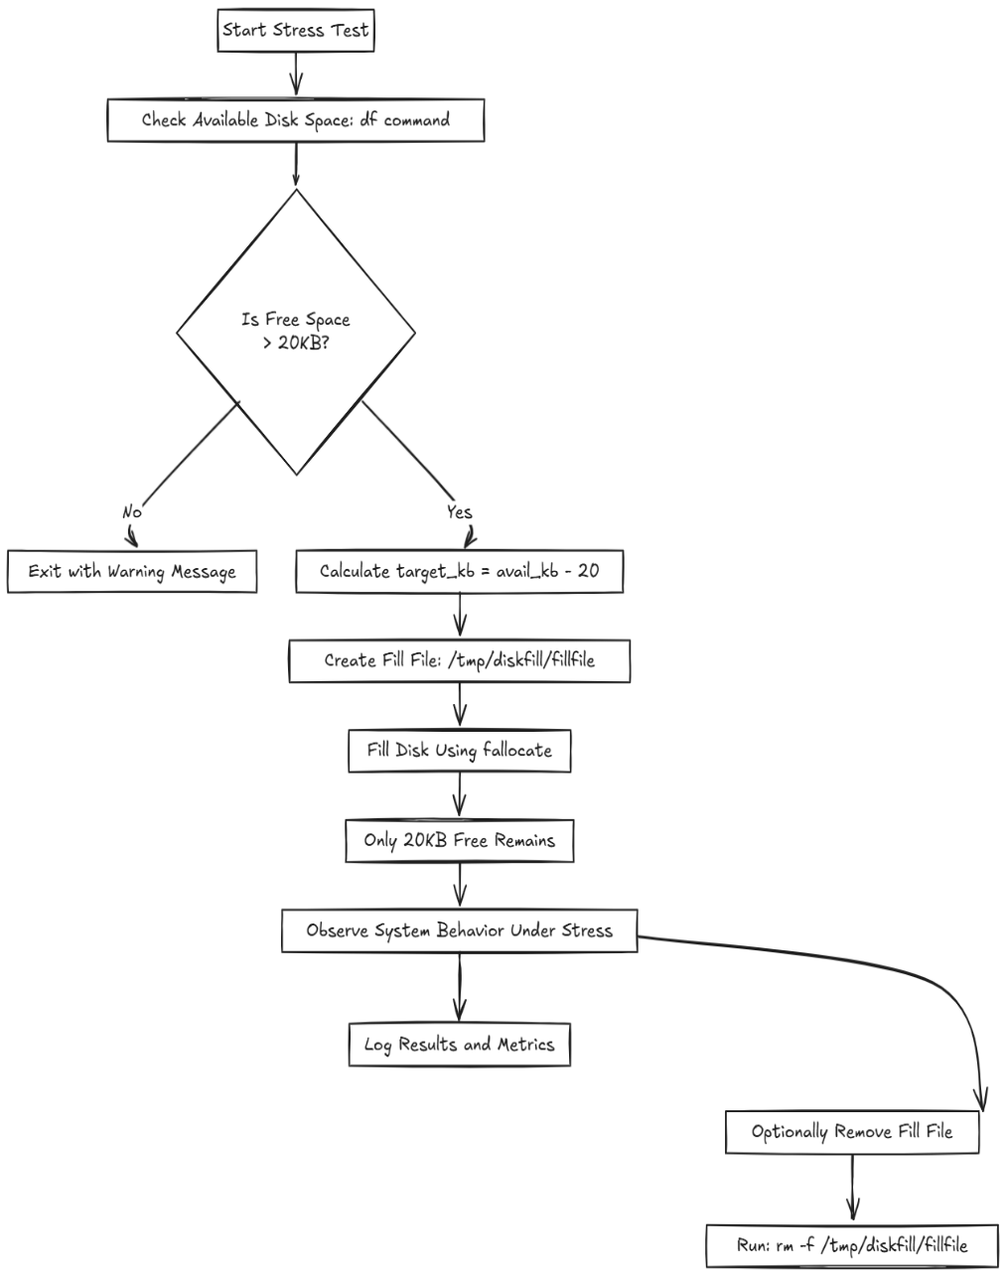
Control-flow:

Slide 14
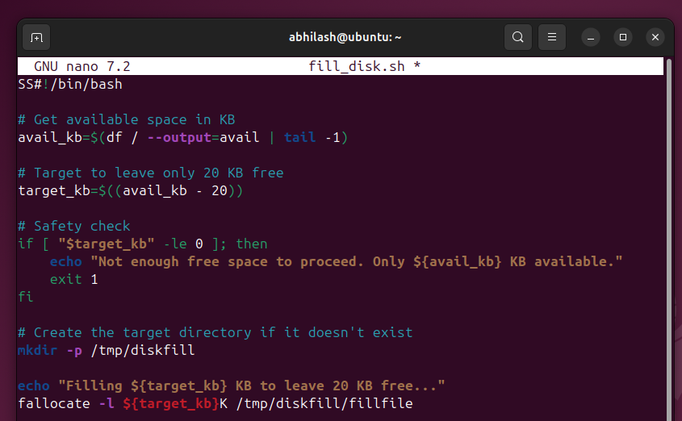
Bash script to fill disk:

Slide 15
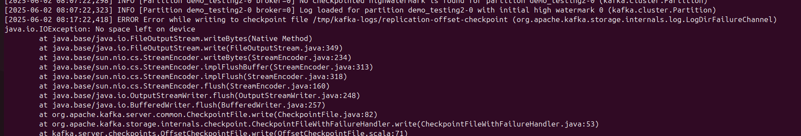

What is happening :
As the disk reached 100% capacity (minus the 20 KB buffer), Kafka brokers started to fail.
Critical components, like the log appender and controller replication, were unable to write to disk.
Kafka logs showed errors like:
No space left on device
Error while appending to log

Slide 16
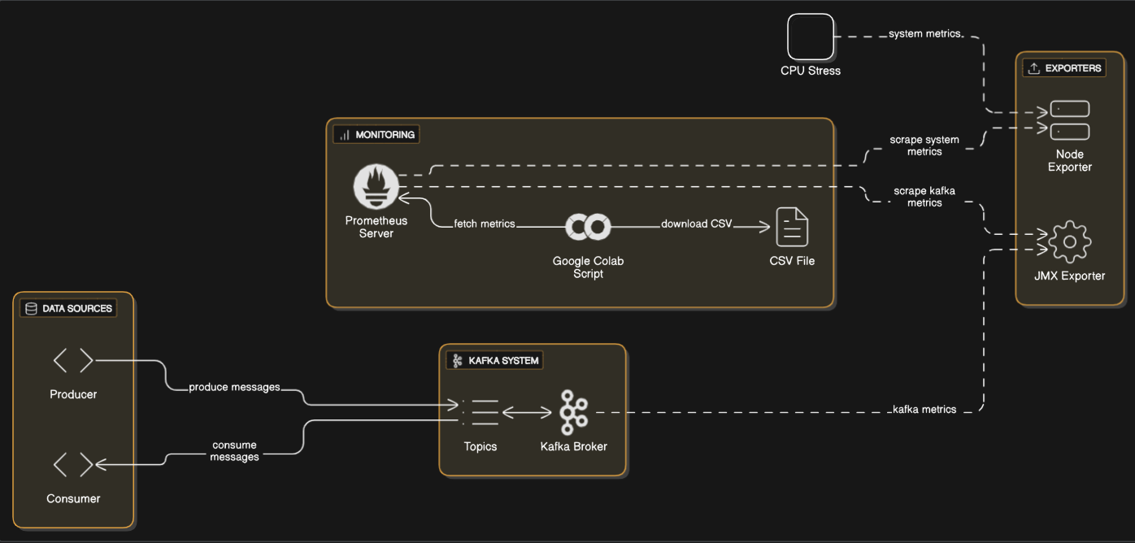
CPU LOAD STRESS TESTING
ARCHITECTURE DIAGRAM:

Slide 17
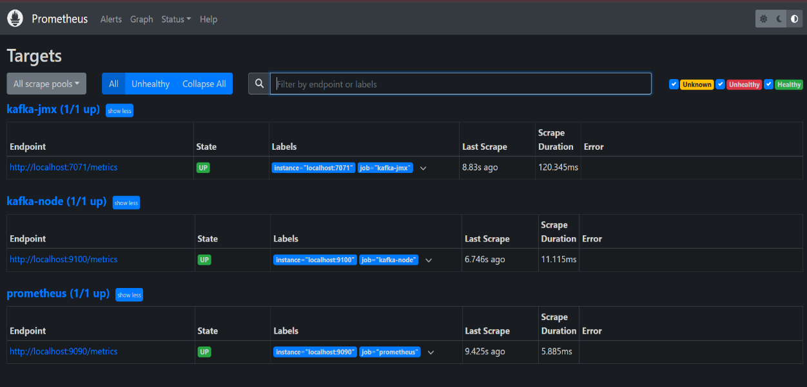
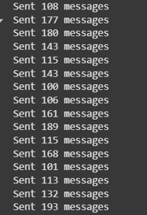
Monitoring Setup:
Node Exporter: Installed on Kafka machine to expose system metrics at :9100/metrics.
JMX Exporter: Attached to Kafka broker to expose Kafka metrics at :7071/metrics.
Prometheus: Configured to scrape both exporters and store time-series metrics.
Producer Script (Run on Google Colab)
This Python script acts as a Kafka message producer, generating 100–200 random sensor readings every second and sending them to a Kafka topic named demo_testing2. Each message contains simulated data and is serialized in JSON format. It uses batching and gzip compression to optimize message delivery and runs continuously until interrupted.

Slide 18
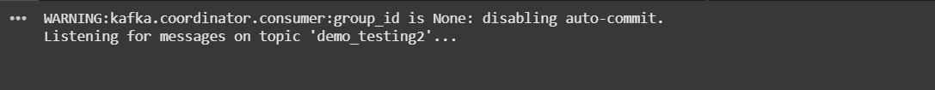
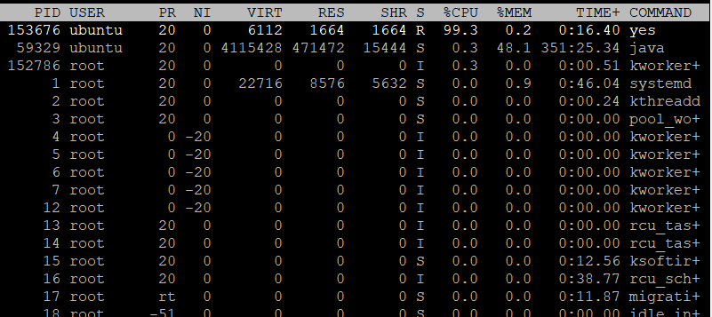
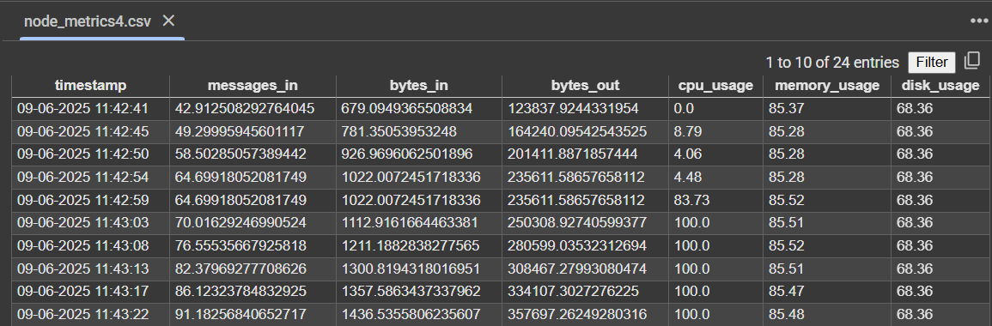
Consumer Script (Run on Google Colab)
The consumer script connects to the same Kafka topic (demo_testing2) and listens for messages starting from the earliest available offset. It decodes each incoming message from UTF-8 and attempts to parse it as JSON.
Stressing the CPU Load:
Command used : yes > /dev/null & and checking with the “top” command
Python Script to log metrics to CSV
This script gathers system-level metrics (CPU, memory, disk) from Node Exporter and Kafka performance metrics (messages/bytes in and out) from JMX Exporter, both running on an EC2 instance. It parses and computes values like average CPU usage using time-based deltas and saves the combined metrics with a timestamp into a CSV file every 4 seconds. The script runs continuously, allowing for periodic logging of system and Kafka health for monitoring or analysis purposes.

Slide 19
Stress Testing and Important Notes
Stress Testing Memory
Use `stress-ng --vm 1 --vm-bytes 90%` to trigger high memory usage.
Service Dependencies
Kafka, Zookeeper, JMX, and Node Exporter must be active.
Memory Pressure
Kafka may terminate if memory usage exceeds 99%.

Slide 20
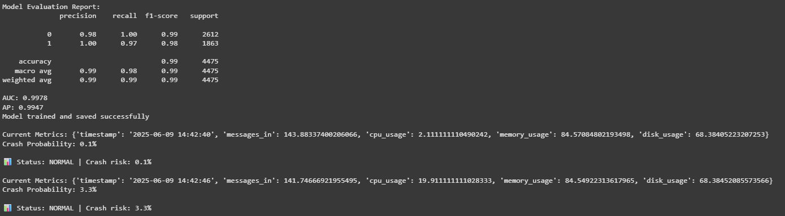
CRASH PREDICTION MODEL
➥ Data Source:
Real-time metrics: messages in, bytes in, CPU, memory, disk (from Prometheus every 6 seconds)
Preprocessing: Filter invalid data, align timestamps
➥ Feature Engineering:
Statistical features: moving average, standard deviation, trends
Prophet forecasts: 1-step forward for messages, CPU, and memory; trend slopes
➥ Final Model:
Type: LightGBM Classifier
Target: Crash (1) or no Crash (0)
Training: periodic (every 5 minutes) with labeled data under normal and stressed conditions

Slide 21
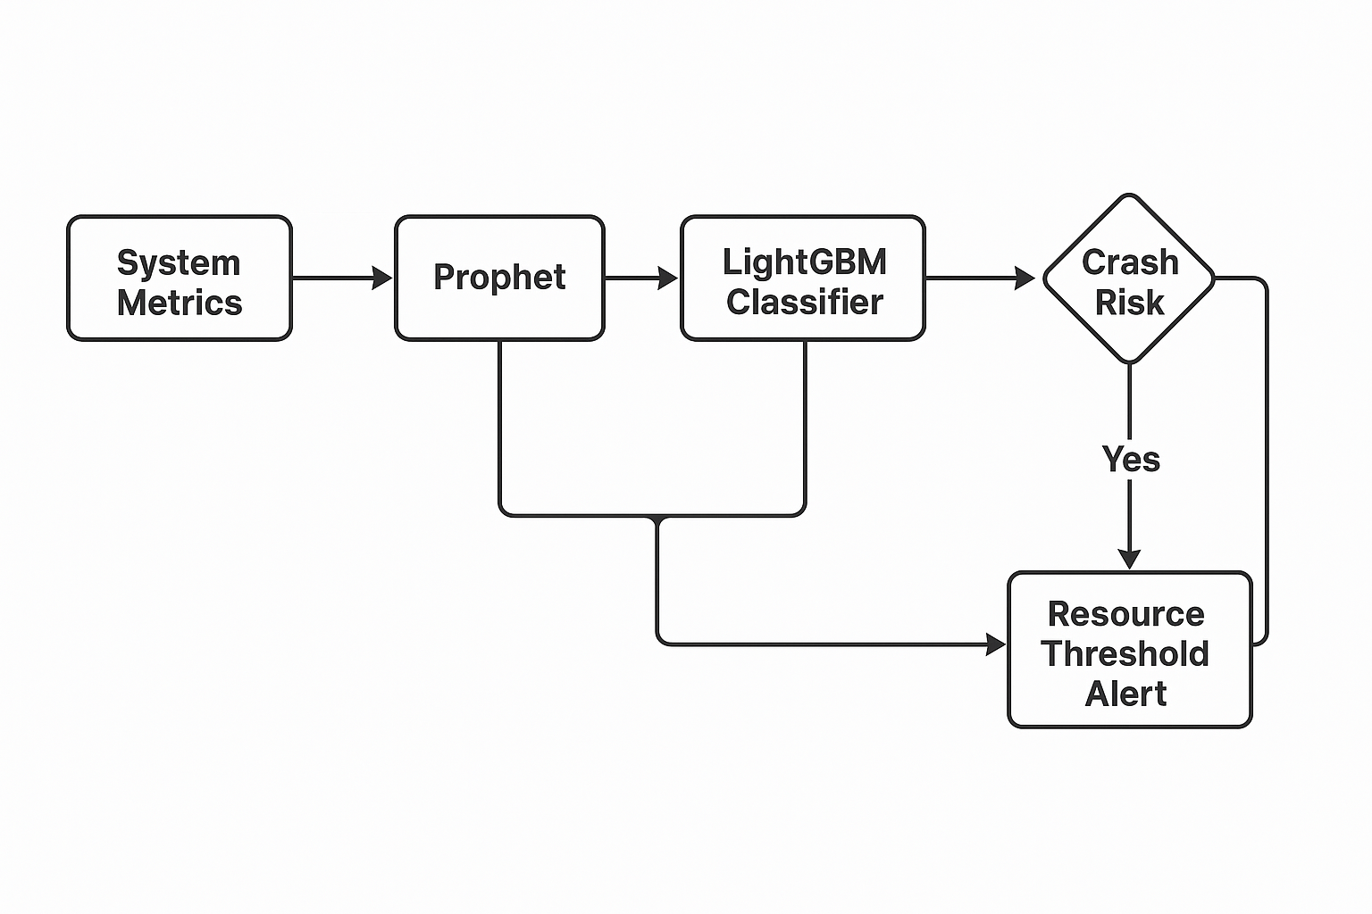
MODEL FLOW AND SUMMARY
➥ Workflow: 1️⃣ Preprocessing: raw metrics → cleaned, standardized 2️⃣ Feature Generation: historical + resource addition 3️⃣ Classification: LightGBM uses 7+ features to predict 5-second forward probability of a crash 4️⃣ Decision: probability smoothed by moving average; severity level assigned (info, low, medium, high, critical)
➥ Strengths: ✅ Combines real-time signals with future trends ✅ Learns from labeled data — less prone to false positives ✅ Adaptable — periodic training lets it stay up to date ✅ Better accuracy and robustness than previous regression approach

Slide 22
MODEL EVOLUTION
1. Linear Regression (Baseline Model)
Goal: Predict CPU usage and Kafka traffic (message rate).
Pros: Simple to implement and interpret.
Limitations:
Could not capture non-linear relationships between system metrics.
Poor generalization under varying load conditions.
Failed to identify early signs of instability or crash.
3. LightGBM Classifier (Crash Prediction Model)
Goal: Classify whether a system is at risk of crash.
Key Change: Trained on labeled crash data instead of just raw metrics.
Enhancements:
Integrated Facebook Prophet to include forecasted metrics (e.g., CPU or Kafka message rate trends).
Used both current and near-future system state as input features.
Outcome:
Significant boost in early warning capability.
Higher precision with reduced false positives in identifying crash-prone conditions.
2. LightGBM Regressor (Improved Accuracy)
Goal: Improve prediction of system resource metrics (e.g., CPU usage).
Pros:
Handled non-linear interactions better than linear models.
Provided better prediction accuracy under dynamic loads.
Limitations:
Crash detection required manual thresholding (e.g., CPU > 85%), which:
Was not adaptive or scalable.
Could miss edge cases or generate false positives.
4. Resource Threshold Alerting (Root Cause Advice)
Goal: Improve interpretability and operational usefulness.
New Target: Predict which resource (CPU, memory, disk, etc.) is violating thresholds, not just message rate.
Purpose:
Enables granular alerting by identifying the specific metric causing issues.
Lays foundation for a capacity advisory system that suggests targeted actions (e.g., scale memory or reduce message rate).
Benefit: Alerts are now context-aware, offering actionable insight into the underlying cause of potential crashes.

Slide 23
CONCLUSION
✅ We successfully implemented an end-to-end pipeline for:
Real-time Kafka and system metric collection (using Node Exporter, JMX, and Prometheus)
Simulating stress conditions to observe behavior under pressure
Training and evaluating a LightGBM classifier to predict crashes based on multivariate signals
✅ The pipeline demonstrated that combining real-time signals with future trends (like Prophet forecasts) can effectively anticipate failures before they happen.
✅ Our approach is adaptive and scalable, allowing for periodic training and future expansion to multi-node clusters and additional signals.
✅ Overall, this framework can help improve resiliency, reduce downtime, and enable proactive scaling and maintenance decisions in distributed Kafka systems.

Slide 24
CHALLENGES: 1. Billing issues on VM (AWS EC2 instance) 2. stress testing and finding the proper simulator code 3. finding the correct structure and algorithm for the model 4. the big difference between stress datapoints and normal datapoints as stress testing can't be done for long hours on a billed AWS. FUTURE ADVANCEMENTS: 1. Expanding on multi node system 2. Improving ml model accuracy 3. Deployment of the system 4. Expanding on more attributes like network i/o

Slide 25
THANKYOU

